Slide 1
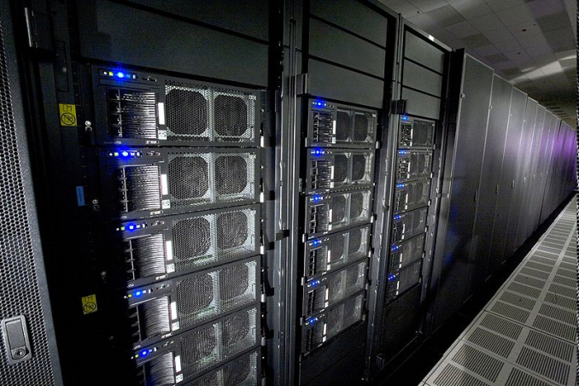
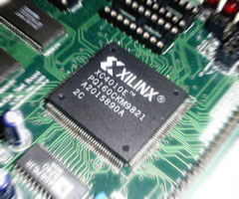
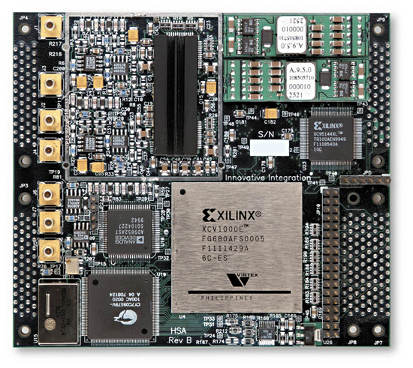
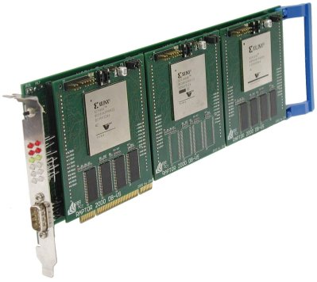
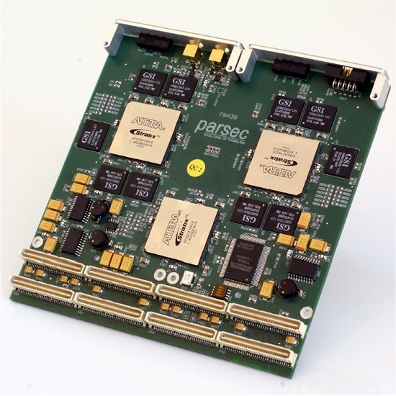
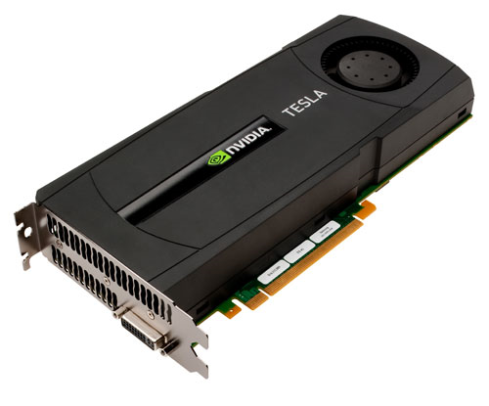

Heterogeneous Computing at USC Dept. of Computer Science and Engineering University of South Carolina
Dr. Jason D. Bakos
Assistant Professor
Heterogeneous and Reconfigurable Computing Lab (HeRC)
This material is based upon work supported by the National Science Foundation under Grant Nos. CCF-0844951 and CCF-0915608.

Slide 2
Heterogeneous Computing
Subfield of computer architecture
Mix general-purpose CPUs with specialized processors
Becoming increasingly popular with high integration densities
GOALs:
Explore the use of specialized processor designs that are designed with radically different designs than traditional CPUs
Develop new programming models and methodologies for these processors

Slide 3
Minimum Feature Size
Year | Processor | Speed | Transistor Size | Transistors
1982 | i286 | 6 - 25 MHz | 1.5 μm | ~134,000
1986 | i386 | 16 – 40 MHz | 1 μm | ~270,000
1989 | i486 | 16 - 133 MHz | .8 μm | ~1 million
1993 | Pentium | 60 - 300 MHz | .6 μm | ~3 million
1995 | Pentium Pro | 150 - 200 MHz | .5 μm | ~4 million
1997 | Pentium II | 233 - 450 MHz | .35 μm | ~5 million
1999 | Pentium III | 450 – 1400 MHz | .25 μm | ~10 million
2000 | Pentium 4 | 1.3 – 3.8 GHz | .18 μm | ~50 million
2005 | Pentium D | 2 threads/package | .09 μm | ~200 million
2006 | Core 2 | 2 threads/die | .065 μm | ~300 million
2008 | Core i7 “Nehalem” | 8 threads/die | .045 μm | ~800 million
2011 | “Sandy Bridge” | 16 threads/die | .032 μm | ~1.2 billion
Year | Processor | Speed | Transistor Size | Transistors
2008 | NVIDIA Tesla | 240 threads/die | .065 μm | 1.4 billion
2010 | NVIDIA Fermi | 512 threads/die | .040 μm | 3 billion

Slide 4
CPU Design
FOR i = 1 to 1000
C[i] = A[i] + B[i]
Core 1
Core 2
CPU
Control
ALU
ALU
Control
ALU
ALU
ALU
ALU
ALU
ALU
time
L1 cache
L1 cache
Copy part of A onto CPU
L2 cache
L2 cache
Copy part of B onto CPU
ADD
ADD
ADD
ADD
L3 cache
Copy part of C into Mem
Copy part of A onto CPU
Copy part of B onto CPU
ADD
ADD
ADD
ADD
Copy part of C into Mem
…

Slide 5
Co-Processor Design
FOR i = 1 to 1000
C[i] = A[i] + B[i]
GPU
cache
ALU
ALU
ALU
ALU
ALU
ALU
ALU
ALU
Core 1
cache
ALU
ALU
ALU
ALU
ALU
ALU
ALU
ALU
Core 2
cache
ALU
ALU
ALU
ALU
ALU
ALU
ALU
ALU
Core 3
cache
ALU
ALU
ALU
ALU
ALU
ALU
ALU
ALU
Core 4
cache
ALU
ALU
ALU
ALU
ALU
ALU
ALU
ALU
Core 5
cache
ALU
ALU
ALU
ALU
ALU
ALU
ALU
ALU
Core 6
cache
ALU
ALU
ALU
ALU
ALU
ALU
ALU
ALU
Core 7
cache
ALU
ALU
ALU
ALU
ALU
ALU
ALU
ALU
Core 8

Slide 6
Heterogeneous Computing
General purpose CPU + special-purpose processors in one system
System I/O controller
Host Memory
CPU
QPI
PCIe
On board
Memory
X58
Co-processor
~25 GB/s
~25 GB/s
~8 GB/s (x16)
?????
~150 GB/s for GeForce 260
host
add-in card

Slide 7
Heterogeneous Computing
Combine CPUs and coprocs
Example:
Application requires a week of CPU time
Offload computation consumes 99% of execution time
49% of code
initialization
0.5% of run time
“hot” loop
99% of run time
2% of code
Kernel speedup | Application speedup | Execution time
50 | 34 | 5.0 hours
100 | 50 | 3.3 hours
200 | 67 | 2.5 hours
500 | 83 | 2.0 hours
1000 | 91 | 1.8 hours
49% of code
clean up
0.5% of run time
co-processor

Slide 8
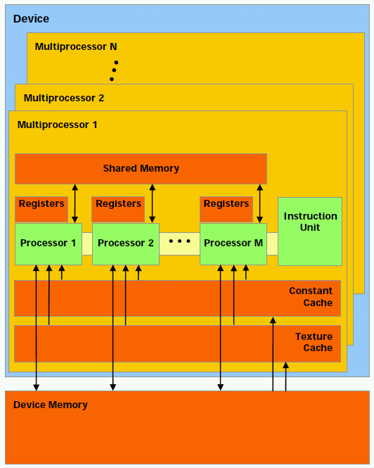
NVIDIA GPU Architecture
Hundreds of simple processor cores
Core design:
Only one instruction from each thread active in the pipeline at a time
In-order execution
No branch prediction
No speculative execution
No support for context switches
No system support (syscalls, etc.)
Small, simple caches
Programmer-managed on-chip scratch memory

Slide 9
Programming GPUs
HOST (CPU) code:
dim3 grid,block;
grid.x=((VECTOR_SIZE/512) + (VECTOR_SIZE%512?1:0));
block.x=512;
cudaMemcpy(a_device,a,VECTOR_SIZE * sizeof(double),cudaMemcpyHostToDevice);
cudaMemcpy(b_device,b,VECTOR_SIZE * sizeof(double),cudaMemcpyHostToDevice);
vector_add_device<<<grid,block>>>(a_device,b_device,c_device);
cudaMemcpy(c_gpu,c_device,VECTOR_SIZE * sizeof(double),cudaMemcpyDeviceToHost);
GPU code:
__global__ void vector_add_device (double *a,double *b,double *c) {
__shared__ double a_s,b_s,c_s;
a_s=a[blockIdx.x*blockDim.x+threadIdx.x];
b_s=b[blockIdx.x*blockDim.x+threadIdx.x];
c_s=a_s+b_s;
c[blockIdx.x*blockDim.x+threadIdx.x]=c_s;
}

Slide 10
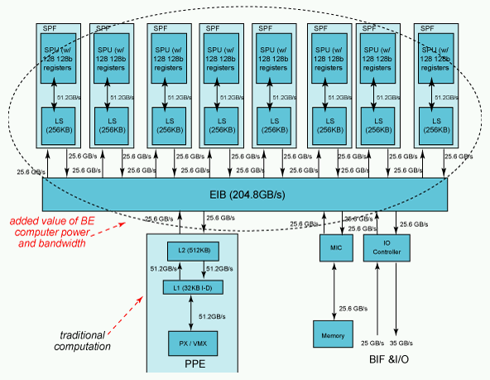
IBM Cell/B.E. Architecture
1 PPE, 8 SPEs
Programmer must manually manage 256K memory and threads invocation on each SPE
Each SPE includes a vector unit like the one on current Intel processors
128 bits wide

Slide 11
High-Performance Reconfigurable Computing
Heterogeneous computing with reconfigurable logic, i.e. FPGAs

Slide 12
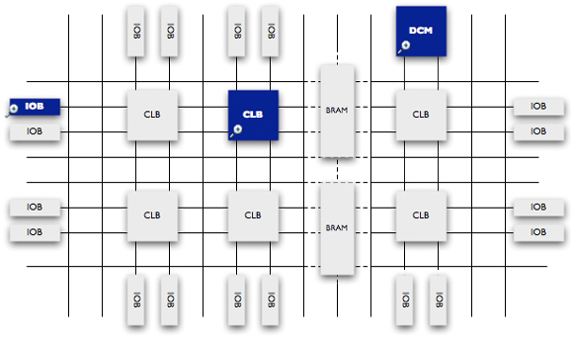
Field Programmable Gate Arrays

Slide 13
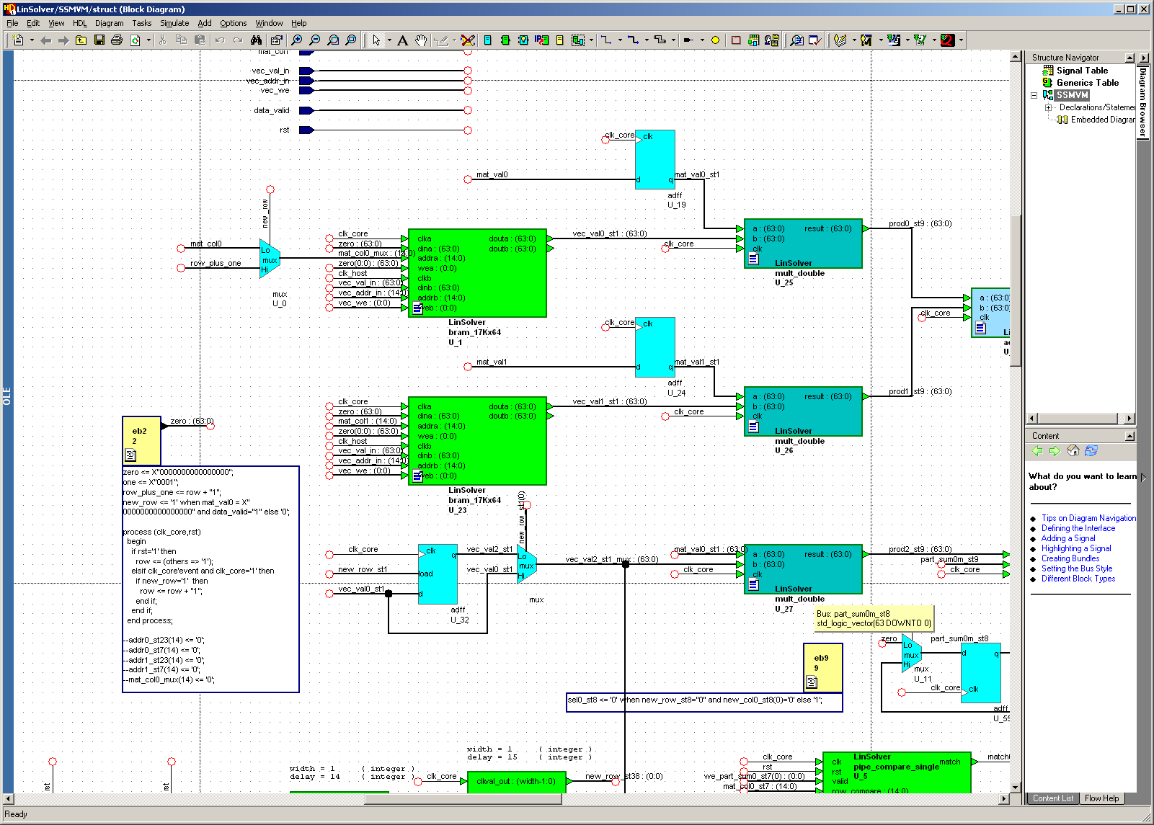
Programming FPGAs

Slide 14
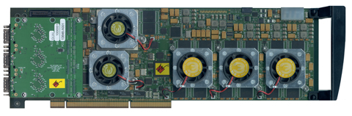
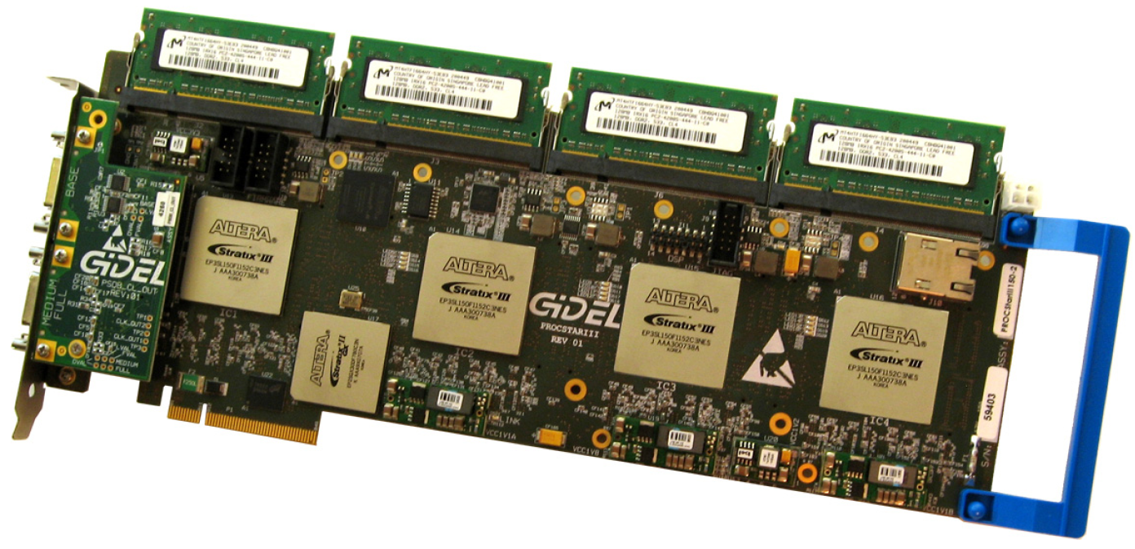
Heterogeneous Computing with FPGAs
Annapolis Micro Systems
WILDSTAR 2 PRO
GiDEL PROCSTAR III

Slide 15
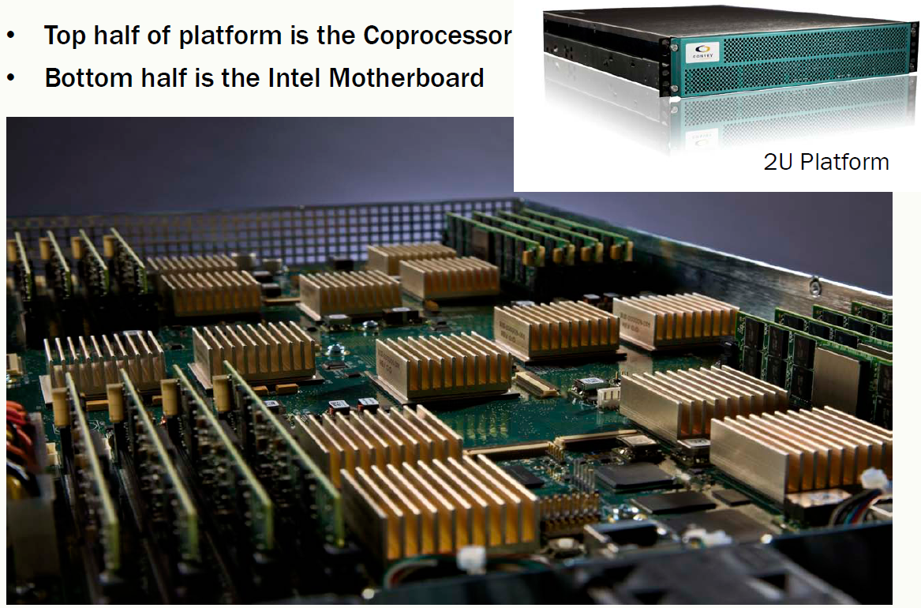
Heterogeneous Computing with FPGAs
Convey HC-1

Slide 16
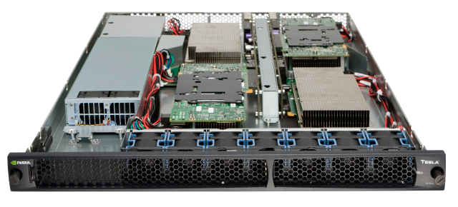
Heterogeneous Computing with GPUs
NVIDIA Tesla S1070

Slide 17
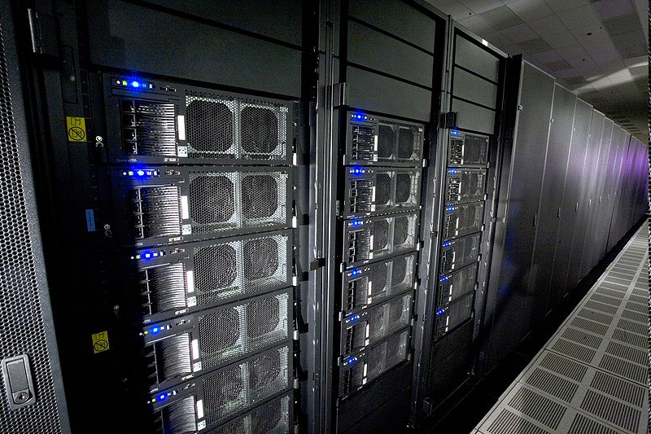
Heterogeneous Computing now Mainstream: IBM Roadrunner
Los Alamos, fastest computer in the world in 2008 (still in Top 10)
6,480 AMD Opteron (dual core) CPUs
12,960 PowerXCell 8i GPUs
Each blade contains 2 Operons and 4 Cells
296 racks
First ever petaflop machine (2008)
1.71 petaflops peak (1.7 billion million fp operations per second)
2.35 MW (not including cooling)
Lake Murray hydroelectric plant produces ~150 MW (peak)
Lake Murray coal plant (McMeekin Station) produces ~300 MW (peak)
Catawba Nuclear Station near Rock Hill produces 2258 MW

Slide 18
Research Problems
What is the best way to design coprocessors? How can we make them faster and easier to program?
Approach: Perform design-space exploration using simulations, mostly in the hands of big companies
What is the best way to design heterogeneous machines? How do we interconnect the CPU and coprocessors?
Approach: PCI-express was the enabler of modern heterogeneous systems and QPI and Hypertransport may make things even easier in the future
However, scalability is still a major problem, right now people use hierarchical systems
How well do certain types of (scientific) programs run on heterogeneous machines? What benefit should we expect?
Approach: Perform “by hand” acceleration of specific applications and report results
How do you modify an arbitrary program to run on a heterogeneous machine?
Approach: Same as above, but use these experiences to develop new development tools and methodologies that are general-purpose

Slide 19
Our Group: HeRC
Applications work
Computational phylogenetics (FPGA/GPU)
GRAPPA and MrBayes
Sparse linear algebra (FPGA/GPU)
Matrix-vector multiply, double-precision accumulators
Data mining (FPGA/GPU)
Logic minimization (GPU)
System architecture
Multi-FPGA interconnects
Tools
Automatic partitioning (PATHS)
Micro-architectural simulation for code tuning

Slide 20
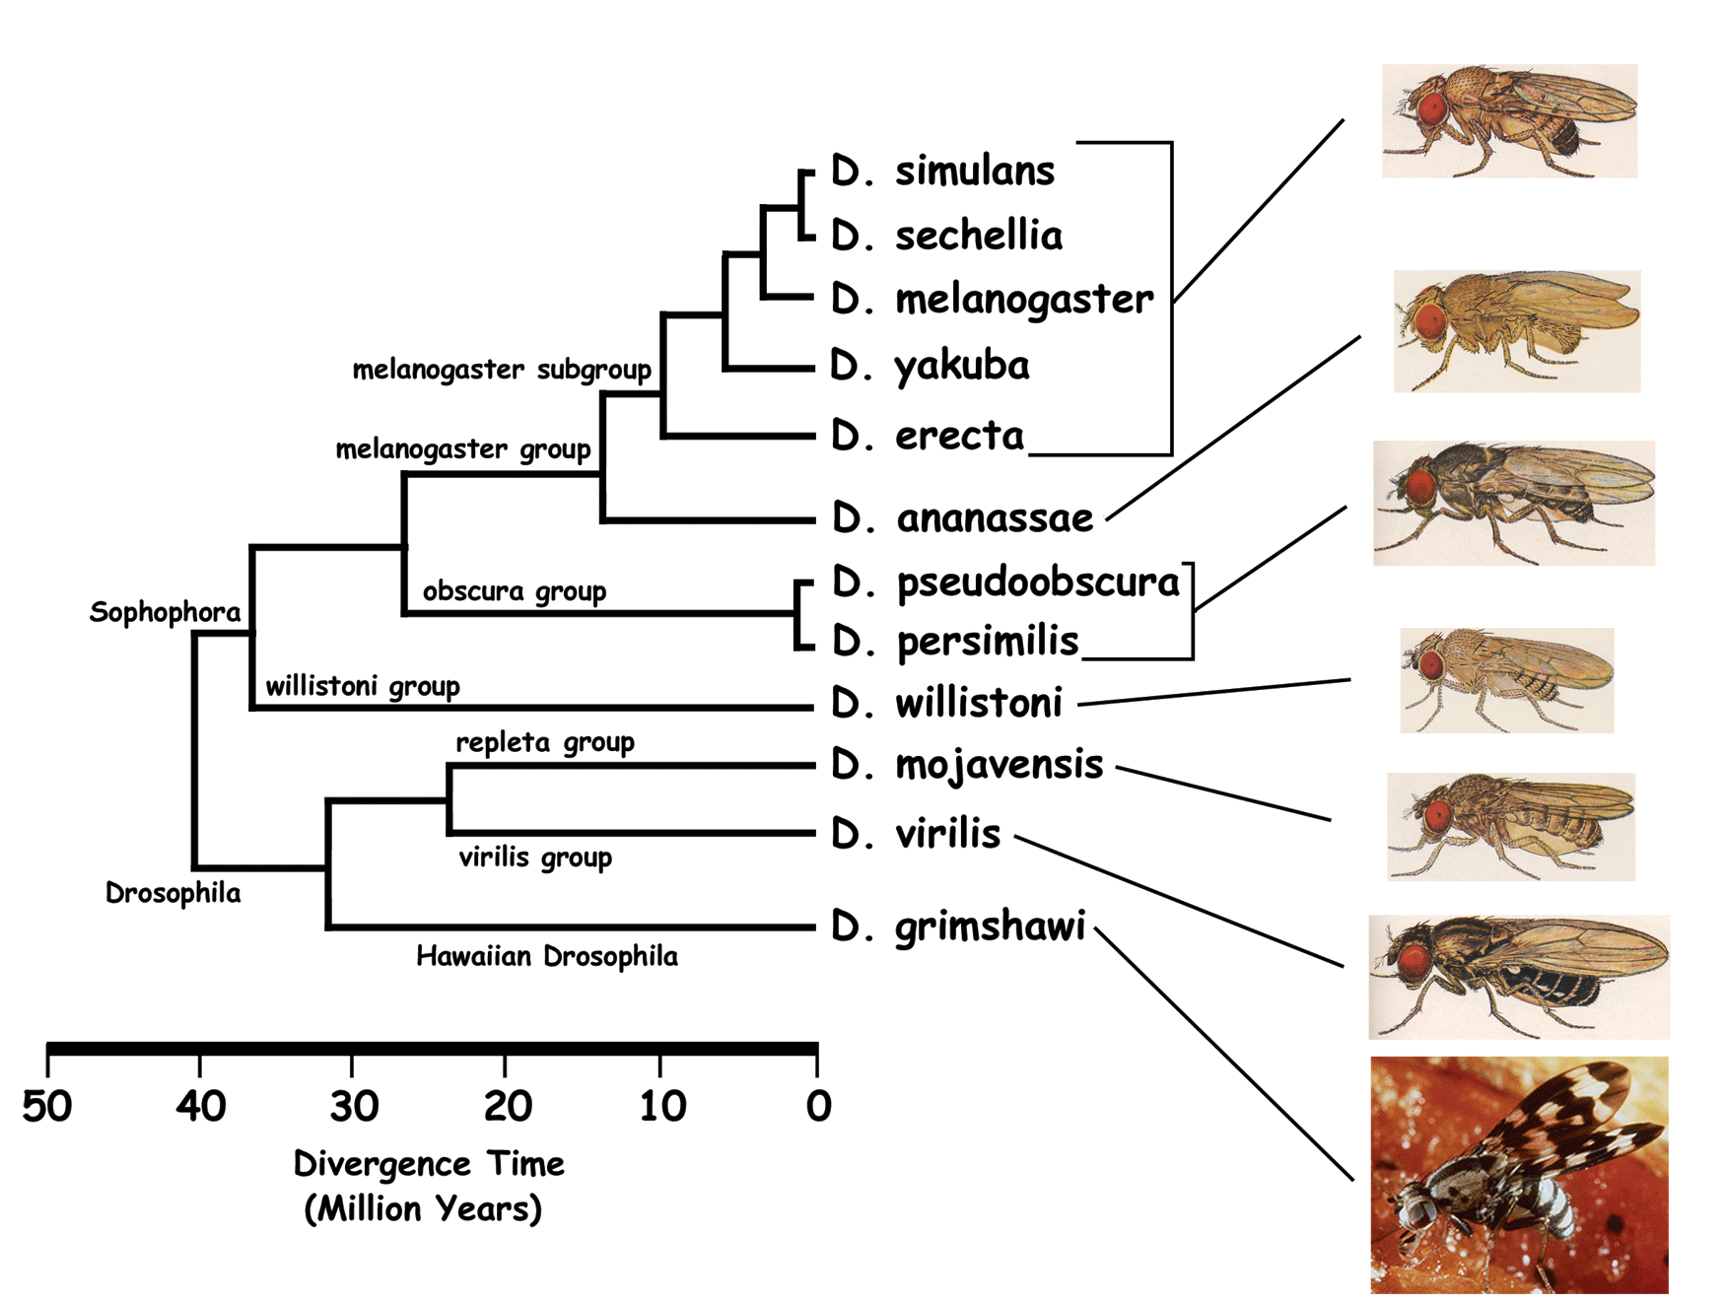
Application: Phylogenies
genus Drosophila

Slide 21
Application: Phylogenies
g3
g1
g4
g2
g1
g3
g2
g5
g5
g5
g6
g4
g6
Unrooted binary tree
n leaf vertices
n - 2 internal vertices (degree 3)
Tree configurations =
(2n - 5) * (2n - 7) * (2n - 9) * … * 3
200 trillion trees for 16 leaves
g6
g3
g5
g2
g1
g4
g5

Slide 22
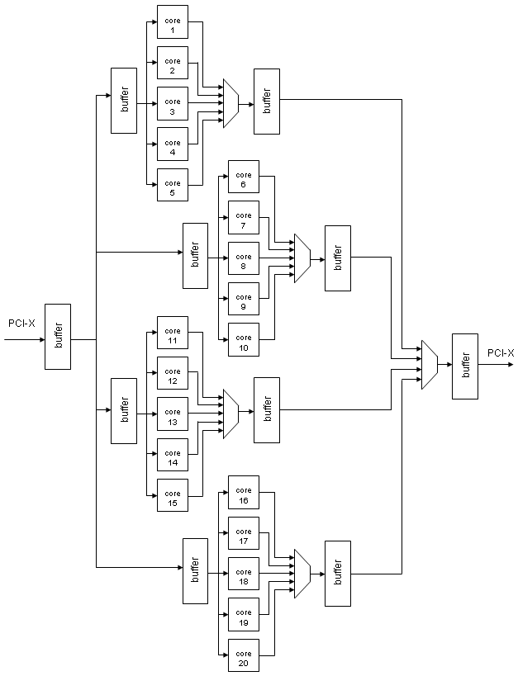
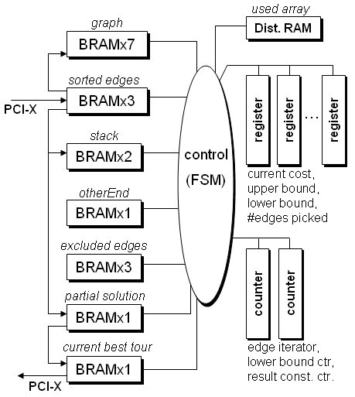
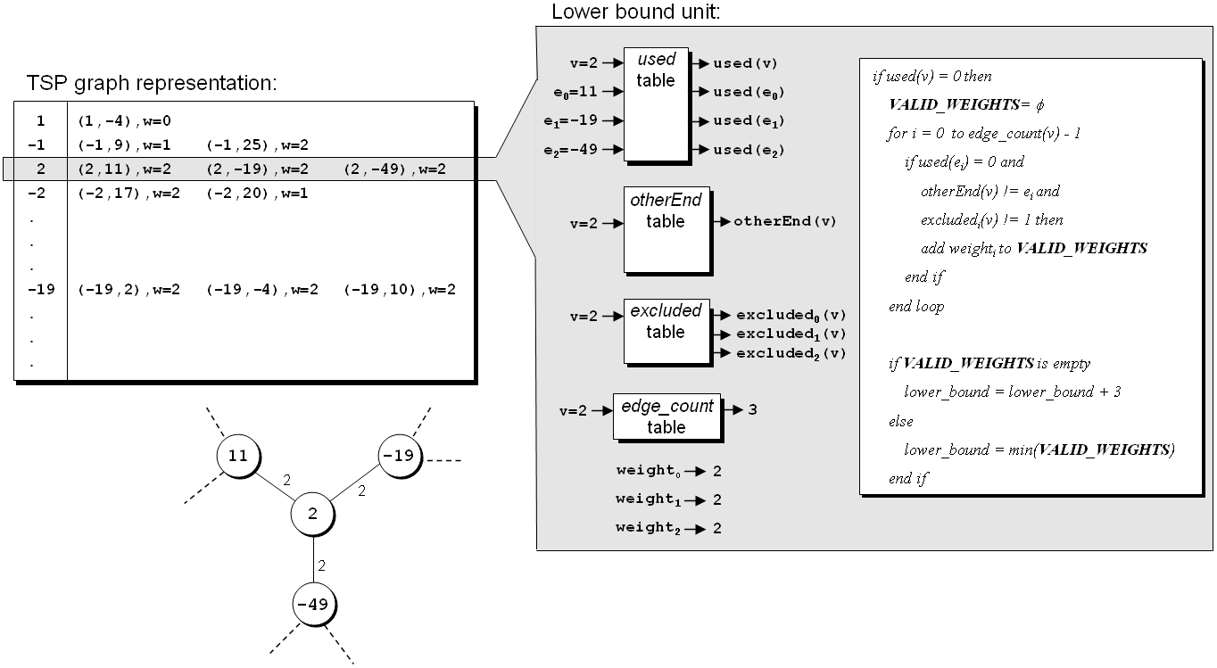
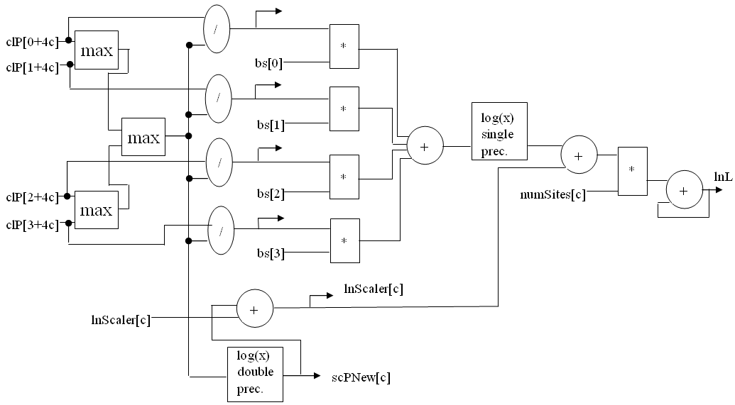
Our Applications Work
FPGA-based co-processors for computational biology
1000X speedup!
Tiffany M. Mintz, Jason D. Bakos, "A Cluster-on-a-Chip Architecture for High-Throughput Phylogeny Search," IEEE Trans. on Parallel and Distributed Systems, in press.
Stephanie Zierke, Jason D. Bakos, "FPGA Acceleration of Bayesian Phylogenetic Inference," BMC Bioinformatics, in press.
Jason D. Bakos, Panormitis E. Elenis, "A Special-Purpose Architecture for Solving the Breakpoint Median Problem," IEEE Transactions on Very Large Scale Integration (VLSI) Systems, Vol. 16, No. 12, Dec. 2008.
Jason D. Bakos, Panormitis E. Elenis, Jijun Tang, "FPGA Acceleration of Phylogeny Reconstruction for Whole Genome Data," 7th IEEE International Symposium on Bioinformatics & Bioengineering (BIBE'07), Boston, MA, Oct. 14-17, 2007.
Jason D. Bakos, “FPGA Acceleration of Gene Rearrangement Analysis,” 15th Annual IEEE International Symposium on Field-Programmable Custom Computing Machines (FCCM'07), April 23-25, 2007.
10X speedup!

Slide 23
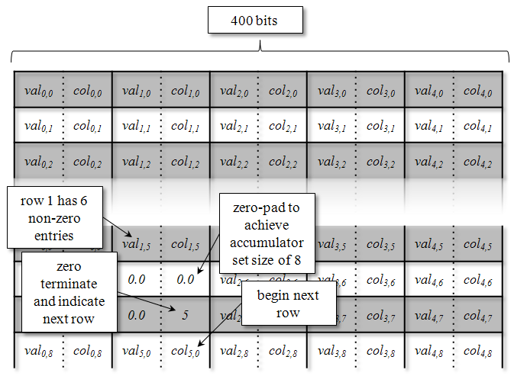
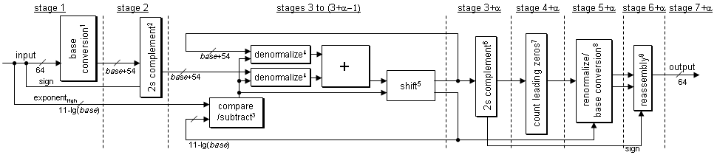
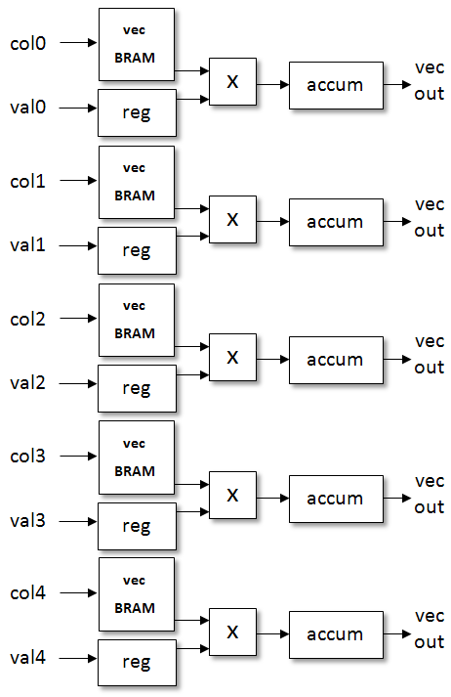
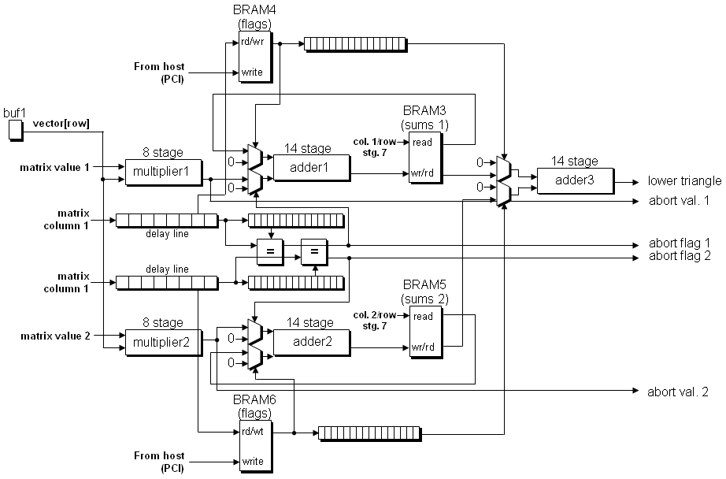
Our Applications Work
FPGA-based co-processors for linear algebra
Krishna.K. Nagar, Jason D. Bakos, "A High-Performance Double Precision Accumulator," IEEE International Conference on Field-Programmable Technology (IC-FPT'09), Dec. 9-11, 2009.
Yan Zhang, Yasser Shalabi, Rishabh Jain, Krishna K. Nagar, Jason D. Bakos, "FPGA vs. GPU for Sparse Matrix Vector Multiply," IEEE International Conference on Field-Programmable Technology (IC-FPT'09), Dec. 9-11, 2009.
Krishna K. Nagar, Yan Zhang, Jason D. Bakos, "An Integrated Reduction Technique for a Double Precision Accumulator," Proc. Third International Workshop on High-Performance Reconfigurable Computing Technology and Applications (HPRCTA'09), held in conjunction with Supercomputing 2009 (SC'09), Nov. 15, 2009.
Jason D. Bakos, Krishna K. Nagar, "Exploiting Matrix Symmetry to Improve FPGA-Accelerated Conjugate Gradient," 17th Annual IEEE International Symposium on Field Programmable Custom Computing Machines (FCCM'09), April 5-8, 2009.

Slide 24
Our Applications Work
FPGA-based co-processors for linear algebra
Krishna.K. Nagar, Jason D. Bakos, "A High-Performance Double Precision Accumulator," IEEE International Conference on Field-Programmable Technology (IC-FPT'09), Dec. 9-11, 2009.
Yan Zhang, Yasser Shalabi, Rishabh Jain, Krishna K. Nagar, Jason D. Bakos, "FPGA vs. GPU for Sparse Matrix Vector Multiply," IEEE International Conference on Field-Programmable Technology (IC-FPT'09), Dec. 9-11, 2009.
Krishna K. Nagar, Yan Zhang, Jason D. Bakos, "An Integrated Reduction Technique for a Double Precision Accumulator," Proc. Third International Workshop on High-Performance Reconfigurable Computing Technology and Applications (HPRCTA'09), held in conjunction with Supercomputing 2009 (SC'09), Nov. 15, 2009.
Jason D. Bakos, Krishna K. Nagar, "Exploiting Matrix Symmetry to Improve FPGA-Accelerated Conjugate Gradient," 17th Annual IEEE International Symposium on Field Programmable Custom Computing Machines (FCCM'09), April 5-8, 2009.

Slide 25
Streaming Double Precision Accumulation
FPGAs allow data to be “streamed” into a computational pipeline
Many kernels targeted for acceleration include
Such as: dot product, used for MVM: kernel for many methods
For large datasets, values delivered serially to an accumulator
Reduction operation
Σ
G+H+I,
set 3
D+E+F,
set 2
A+B+C,
set 1
I,
set 3
H,
set 3
G,
set 3
F,
set 2
E,
set 2
D,
set 2
C,
set 1
B,
set 1
A,
set 1

Slide 26
The Reduction Problem
Basic Accumulator Architecture
Feedback Loop
+
Adder Pipeline
Partial sums
Reduction Ckt
Control
Required Design
Mem
Mem

Slide 27
Sparse Matrix-Vector Multiply
0
1
2
3
4
5
6
7
8
9
10
A
0
0
0
B
0
val
A
B
C
D
E
F
G
H
I
J
K
0
0
0
C
0
D
E
0
0
0
F
G
col
0
4
3
5
0
4
5
0
2
4
3
H
0
0
0
0
0
0
0
I
0
J
0
ptr
0
2
4
7
8
10
11
0
0
0
K
0
0
Group vol/col
Zero-terminate
(A,0) (B,4) (0,0) (C,3) (D,4) (0,0)…

Slide 28
New SpMV Architecture
Delete tree, replicate accumulator, schedule matrix data:
400 bits
val_{0,0} | col_{0,0} | val_{1,0} | col_{1,0} | val_{2,0} | col_{2,0} | val_{3,0} | col_{3,0} | val_{4,0} | col_{4,0}
val_{0,1} | col_{0,1} | val_{1,1} | col_{1,1} | val_{2,1} | col_{2,1} | val_{3,1} | col_{3,1} | val_{4,1} | col_{4,1}
val_{0,2} | col_{0,2} | val_{1,2} | col_{1,2} | val_{2,2} | col_{2,2} | val_{3,2} | col_{3,2} | val_{4,2} | col_{4,2}
val_{0,3} | col_{0,3} | val_{1,3} | col_{1,3} | val_{2,3} | col_{2,3} | val_{3,3} | col_{3,3} | val_{4,3} | col_{4,3}
val_{0,4} | col_{0,4} | val_{1,4} | col_{1,4} | val_{2,4} | col_{2,4} | val_{3,4} | col_{3,4} | val_{4,4} | col_{4,4}
val_{0,5} | col_{0,5} | val_{1,5} | col_{1,5} | val_{2,5} | col_{2,5} | val_{3,5} | col_{3,5} | val_{4,5} | col_{4,5}
val_{0,6} | col_{0,6} | 0.0 | 0.0 | val_{2,6} | col_{2,6} | val_{3,6} | col_{3,6} | val_{4,6} | col_{4,6}
val_{0,7} | col_{0,7} | 0.0 | 5 | val_{2,7} | col_{2,7} | val_{3,7} | col_{3,7} | val_{4,7} | col_{4,7}
val_{0,8} | col_{0,8} | val_{5,0} | col_{5,0} | val_{2,8} | col_{2,8} | val_{3,8} | col_{3,8} | val_{4,8} | col_{4,8}

Slide 29
Performance Comparison
If FPGA Memory bandwidth scaled by adding multipliers/ accumulators to match GPU Memory Bandwidth for each matrix separately
GPU Mem. BW (GB/s) | FPGA Mem BW (GB/s)
58.00 | 51.0 GB/s (x6)
57.03 | 51.0 GB/s (x6)
52.58 | 51.0 GB/s (x6)
49.16 | 42.5 GB/s (x5)
40.23 | 34 GB/s (x4)
26.64 | 25.5 GB/s (x3)
25.68 | 25.5 GB/s (x3)
27.66 | 25.5 GB/s (x3)
27.08 | 25.5 GB/s (x3)

Slide 30
Sequence Alignment
DNA/protein sequence, e.g.
TGAGCTGTAGTGTTGGTACCC => TGACCGGTTTGGCCC
Goal: align the two sequences against substitutions and deletions:
TGAGCTGTAGTGTTGGTACCC
TGAGCTGT----TTGGTACCC
Used for sequence comparison and database search

Slide 31
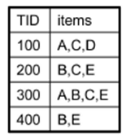
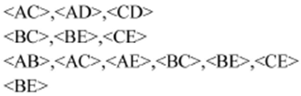
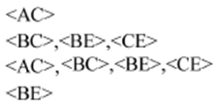
GPU and FPGA Acceleration of Data Mining
Minimum support=2
<BCE>
<ABC>, <ABE>, <ACE>, <BCE>

Slide 32
Our Applications Work
GPU Acceleration of Two Level Logic Minimization
1. Ibrahim Savran, Jason D. Bakos, "GPU Acceleration of Near-Minimal Logic Minimization," 2010 Symposium on Application Accelerators in High Performance Computing (SAAHPC'10), July 13-15, 2010.
A’B’CD
A | B | C | D | out
0 | 0 | 0 | 0 | 1
0 | 0 | 1 | 0 | 1
0 | 1 | 1 | 1 | 1
0 | 1 | 1 | 0 | 1
1 | 1 | 1 | 1 | 0
1 | 0 | 1 | 1 | 0
0 | 1 | 0 | 1 | 0
anything else |  |  |  | X
A’B’C’D
A’B’
A’B’D’
A’B’CD
A’B’CD’
A’C
A’BC
(ACD)’
(A’BC’D)’

Slide 33
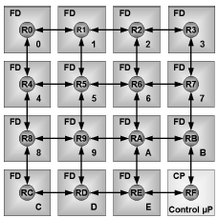
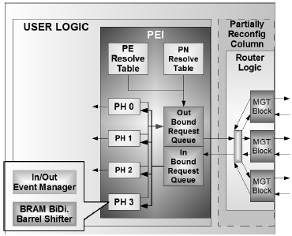
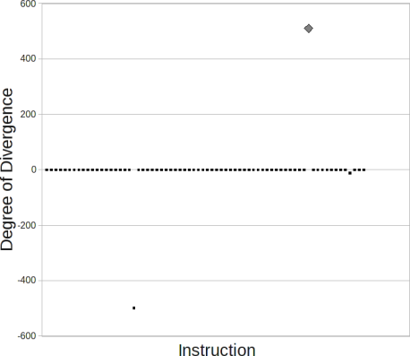
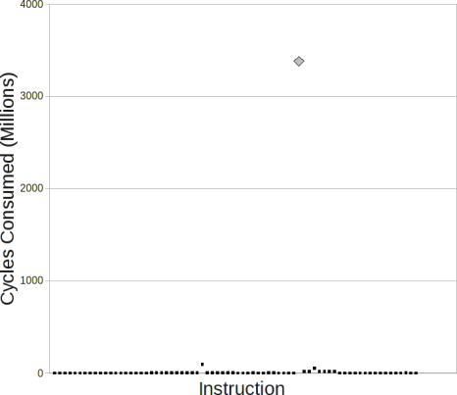
Our Projects
Multi-FPGA System Architectures
Jason D. Bakos, Charles L. Cathey, E. Allen Michalski, "Predictive Load Balancing for Interconnected FPGAs," 16th International Conference on Field Programmable Logic and Applications (FPL'06), Madrid, Spain, August 28-30, 2006.
Charles L. Cathey, Jason D. Bakos, Duncan A. Buell, "A Reconfigurable Distributed Computing Fabric Exploiting Multilevel Parallelism," 14th Annual IEEE International Symposium on Field-Programmable Custom Computing Machines (FCCM'06), April 24-26, 2006.
GPU Simulation
Patrick A. Moran, Jason D. Bakos, "A PTX Simulator for Performance Tuning CUDA Code," IEEE Trans. on Parallel and Distributed Systems, submitted.

Slide 34
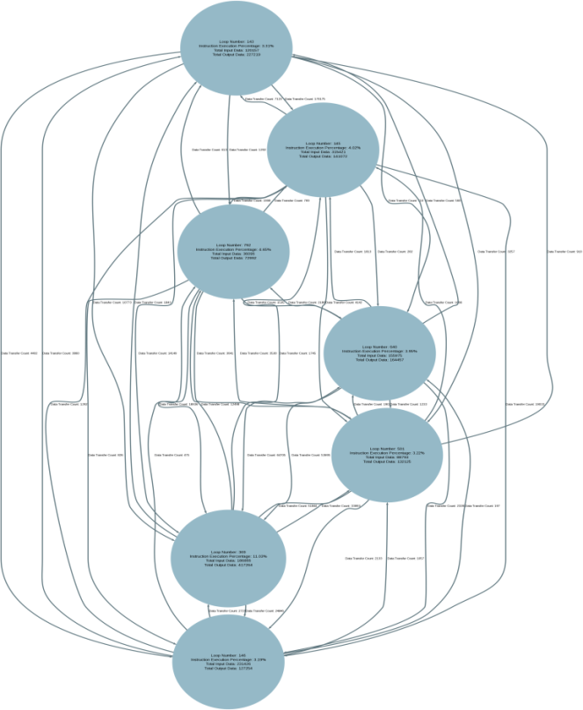
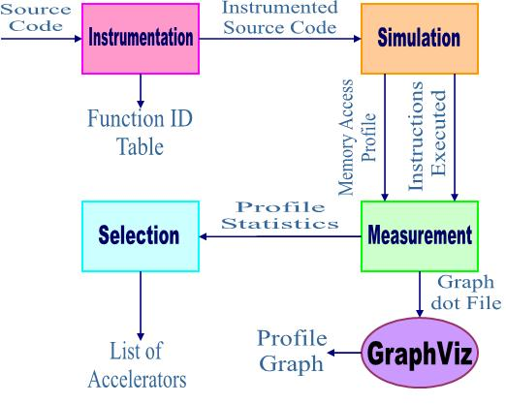
PATHS: Task Partitioning for Heterogeneous Computing

Slide 35
High-Level Synthesis
Input bandwidth-constrained high-level synthesis
Example: 16-input expression:
out = (AA1 * A1 + AC1 * C1 + AG1 * G1 + AT1 * T1) *
(AG2 * A2 + AC2 * C2 + AG2 * G2 + AT2 * T2)

Slide 36
Contact Information
Jason D. Bakos
Office: 3A52
E-mail: jbakos@sc.edu
http://www.cse.sc.edu/~jbakos
Heterogeneous and Reconfigurable Computing (HeRC) Lab:
Lab: 3D15
http://herc.cse.sc.edu

Slide 37
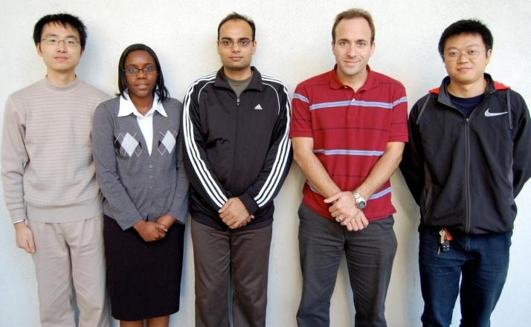
Acknowledgement
Tiffany Mintz
Krishna Nagar
Jason Bakos
Yan Zhang
Zheming Jin
Heterogeneous and Reconfigurable Computing Group
http://herc.cse.sc.edu

